Slide 1
Secure Data Hiding In Images Using Steganography
CAPSTONE PROJECT
Presented By: Rathod Harshvardhansinh
Student Name : Rathod Harshvardhansinh
College Name : Sankalchand Patel College Of Engineering Department : Information Technology

Slide 2
OUTLINE
Problem Statement
Technology used
Wow factor
End users
Result
Conclusion
Git-hub Link
Future scope

Slide 3
Problem Statement
Secure communication is crucial in protecting sensitive information from unauthorized access.
This project utilizes steganography to hide secret data within images.
The technique embeds encrypted messages into image pixels, ensuring confidentiality.
It enables covert data transmission without raising suspicion.
The goal is to develop an efficient and user-friendly system for secure communication.

Slide 4
Technology used
Programming Language: Python
Image Processing Library: OpenCV
Graphical User Interface (GUI): Tkinter
File Handling & Security: Basic encryption logic for password protection
Additional Libraries: Pillow (for image handling)
Platform: Windows 11

Slide 5
Wow factors
Uses steganography to embed a message into an image without noticeable changes.
User-friendly GUI for easy encryption and decryption.
Lossless data hiding using pixel value manipulation instead of traditional cryptographic techniques.
Works on any standard image file format (PNG recommended for best results).

Slide 6
End users
Cybersecurity Enthusiasts – Exploring secure communication techniques.
Government & Defense – Secure message transmission without raising suspicion.
Journalists & Activists – Concealing sensitive information in images to avoid surveillance.
Software Developers – Learning steganography concepts and their applications.

Slide 7
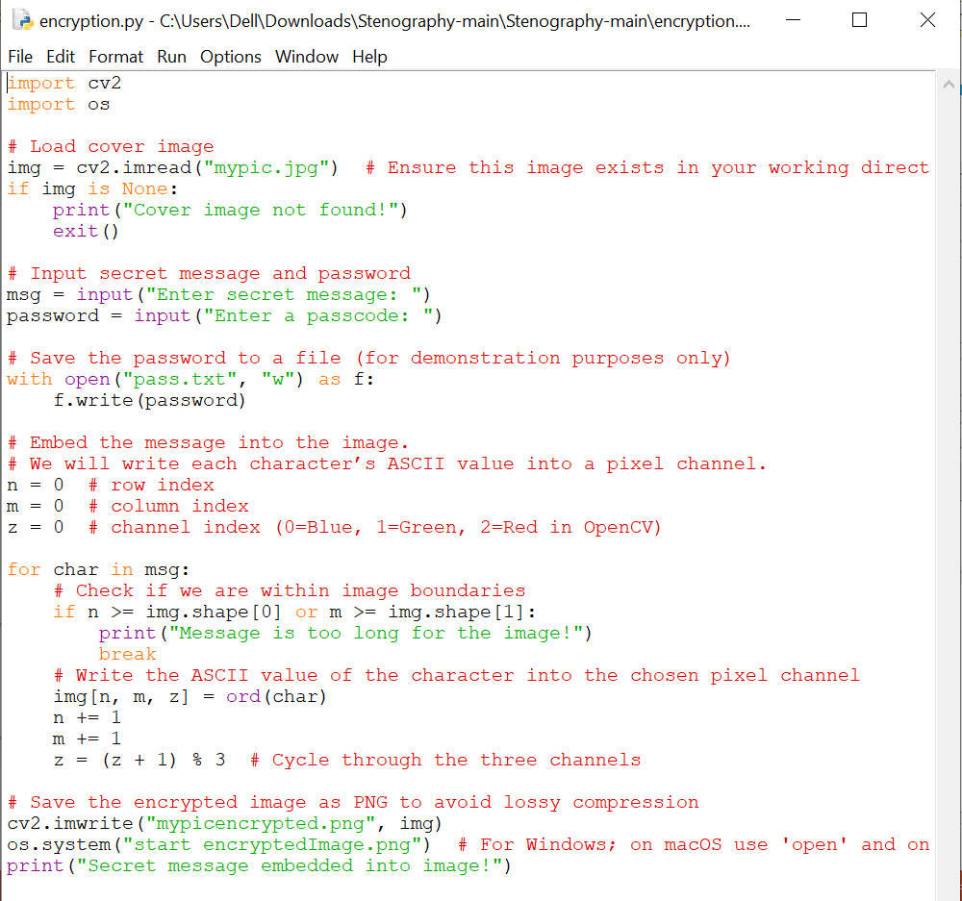
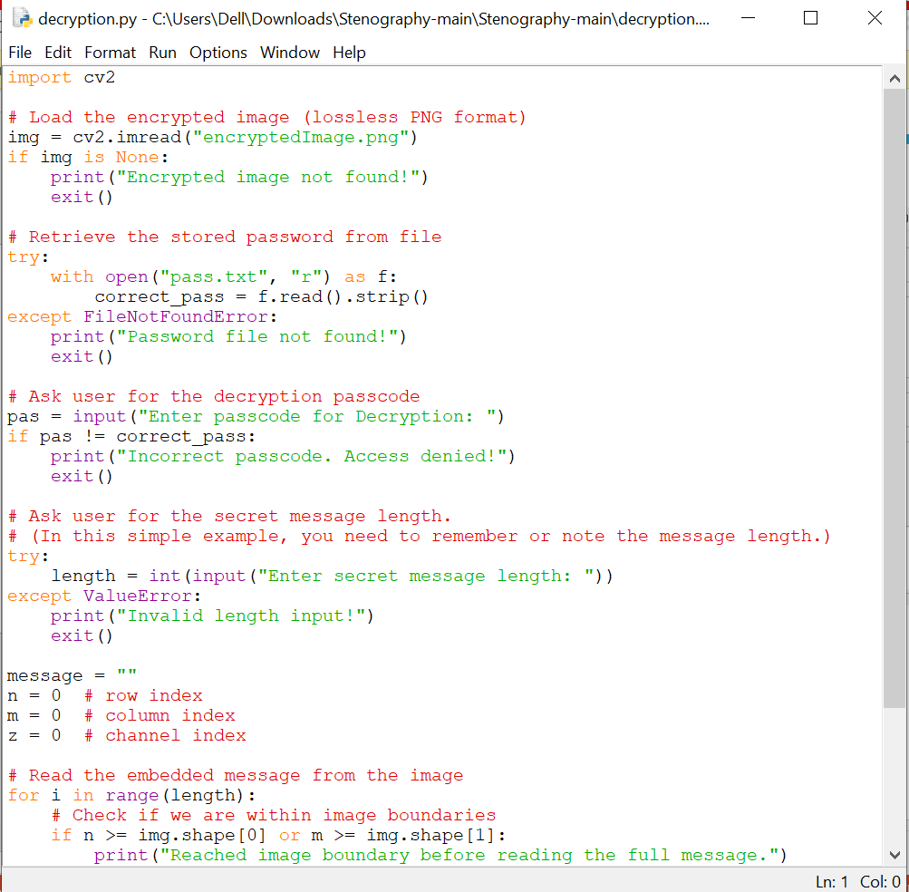
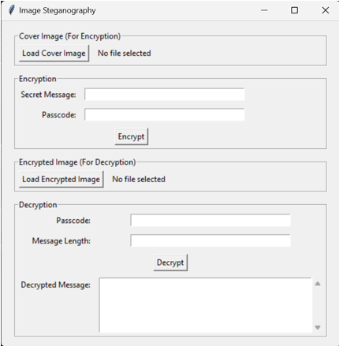

Results
Encryption Code:
Decryption Code:
GUI :
Input Image File:
Output Image File:

Slide 8
Conclusion
Steganography provides a covert way of communicating sensitive information.
This project showcases a simple yet effective implementation of message hiding in images.
The GUI makes encryption and decryption accessible even to non-technical users.
Future improvements can make it more robust, secure, and scalable.

Slide 9
GitHub Link
https://github.com/RathodHarshvardhansinh/My_Project_1.git

Slide 10
Future scope(optional)
Stronger Security – Using AES/RSA encryption before embedding.
AI Integration – Enhancing hiding techniques with machine learning.
Higher Capacity – Storing more data without quality loss.
Real-Time Use – Secure messaging & cloud integration.
Cross-Platform – Mobile & web-based access.
Detection Prevention – Anti-forensic methods to avoid detection.
Multi-Layer Steganography – Hiding data in images, audio, or video.

Slide 11
THANK YOU

